Slide 1
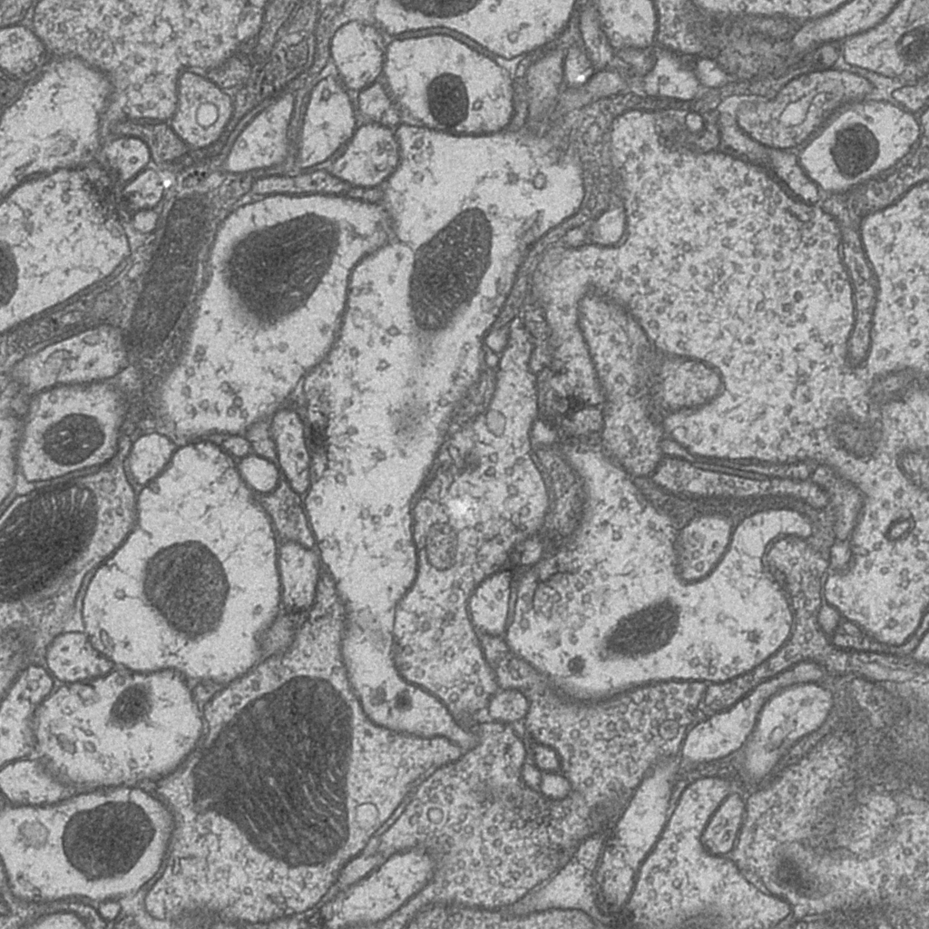
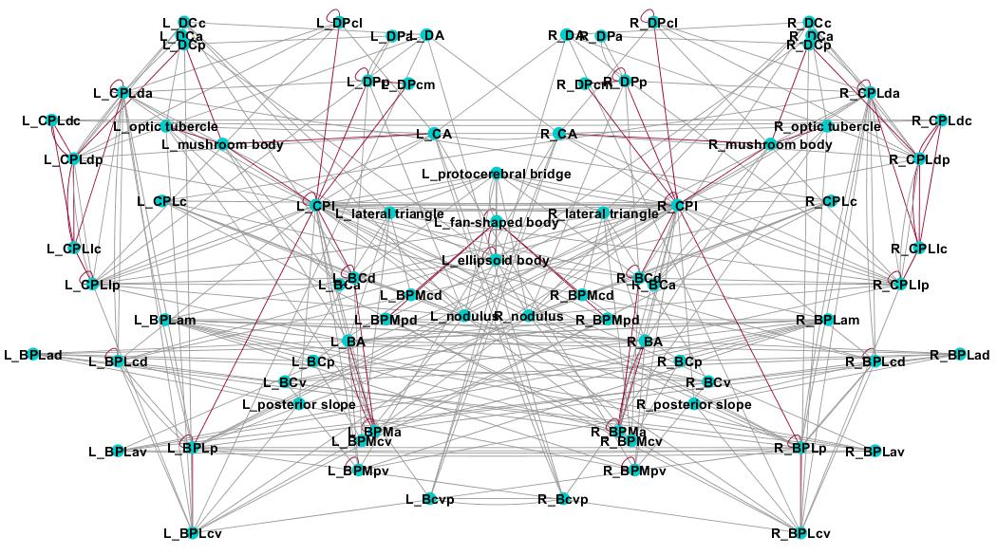
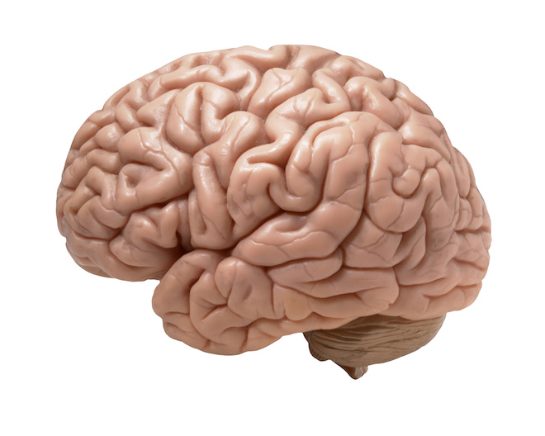
EM Segmentation in Connectomics a User’s Perspective
EM
?
connectome graph
Stephen Plaza
Notes:
…perhaps with some bias toward segmentation in fly datasets, though observations should generalize across different organisms and EM imaging strategies.

Slide 2
Presentation goals
Summarize the state of EM segmentation for connectomics
Better define segmentation evaluation objectives
Propose potential solutions and work directions

Slide 3
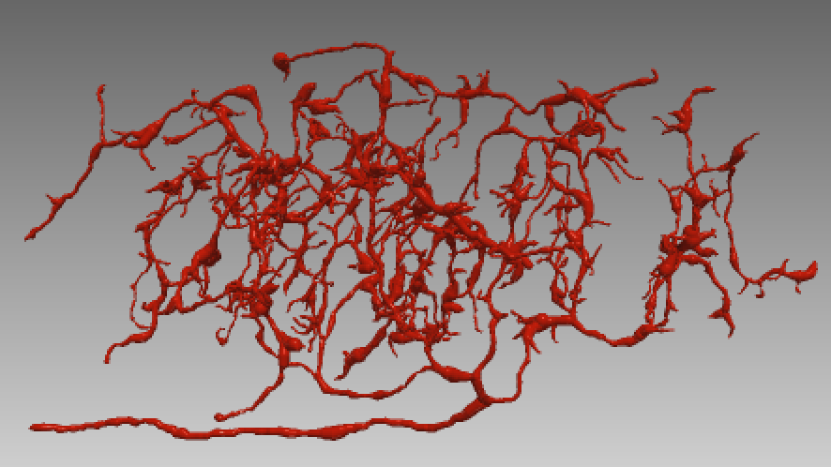
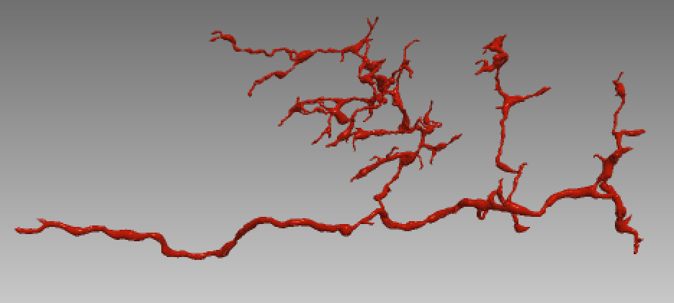
State of EM segmentation
Current high-level objective: extract neuronal objects from data (can then be used to extract the connectome)
Segmentation objective: accuracy of pixel assignment (e.g, Rand Index, VI) ==> “near-human” performance (usually on tiny datasets)
However…
We are not close to automatically extracting a connectome! ==> requires A LOT of manual proofreading/editing
EM
Neurons
Notes:
Performance objective tries to capture the quality of partitioning image data into distinct neuronal shapes. Rand index and variation of information (VI) are two commonly used metrics. Metrics are evaluated over image space.

Slide 4
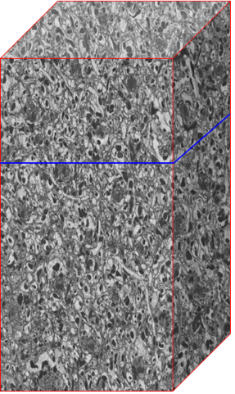
High-level EM segmentation strategy
Classifying neurons directly from grayscale is very challenging
Neurons are high-dimensional
Neurons can span thousands of images
Current strategies: divide the problem into several stages, over small patches

Slide 5
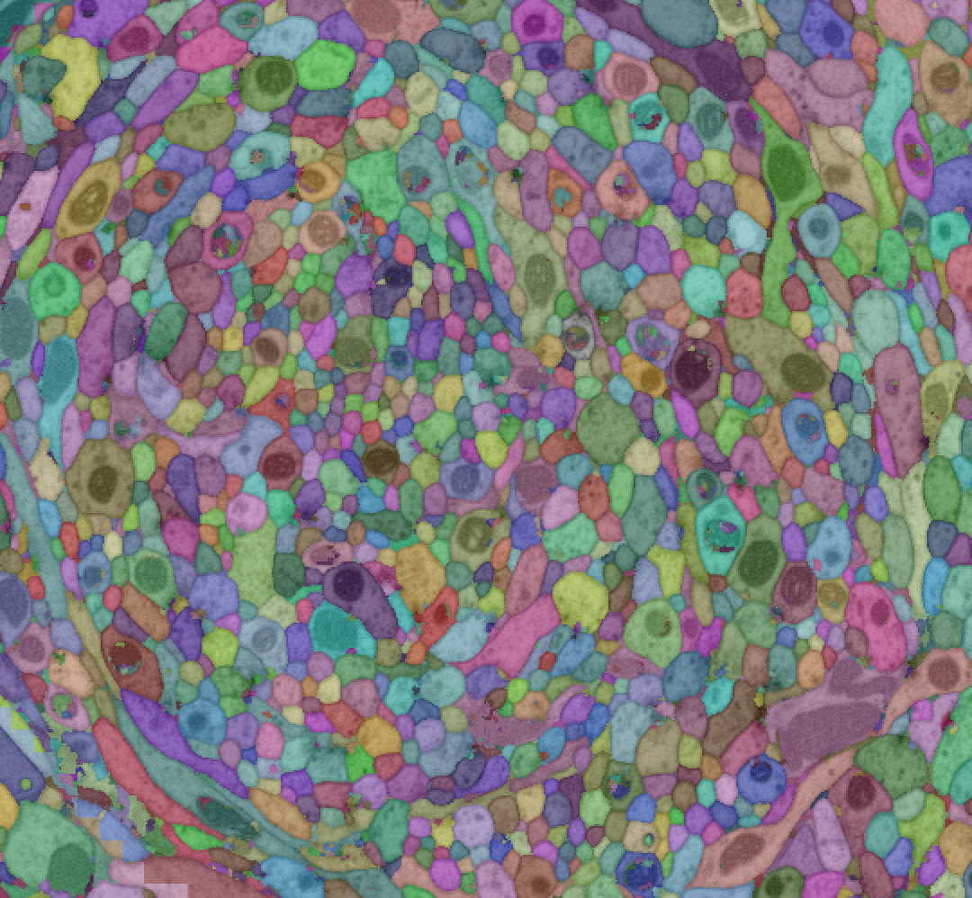
High-level EM segmentation strategy (pt. 2)
over- segmentation (conservative)
merge regions
segmentation
image stack
Boundary Prediction
Watershed
Agglomeration
Boundary prediction classification over small patches (different loss functions: pixel based, MALIS, etc)
Agglomeration: optimize merge/split errors (generally harder to manually proofread false merge errors)
Basically unchanged in the last several years
manual proofreading
Notes:
Boundary prediction objective to minimize pixel error or MALIS on small patches. Agglomeration objective to optimize for merge/split Rand/VI errors. Is this best way to decompose this problem space?

Slide 6
Challenges

Slide 7
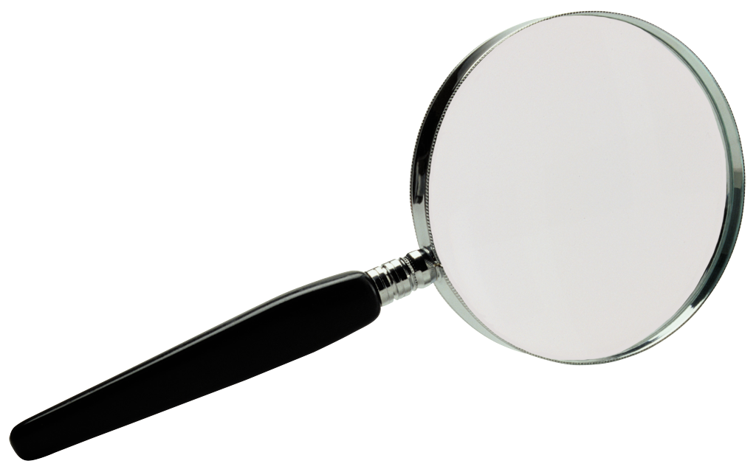
High-level: why segmentation is challenging
Complex neuron shapes, spans 1000s of images
Requires big data computation → challenging entry point for researchers
Neuronal shapes poorly characterized
Computation done in several steps, over small windows → more heuristics, tuning, and points of failure
Intricate shape

Slide 8
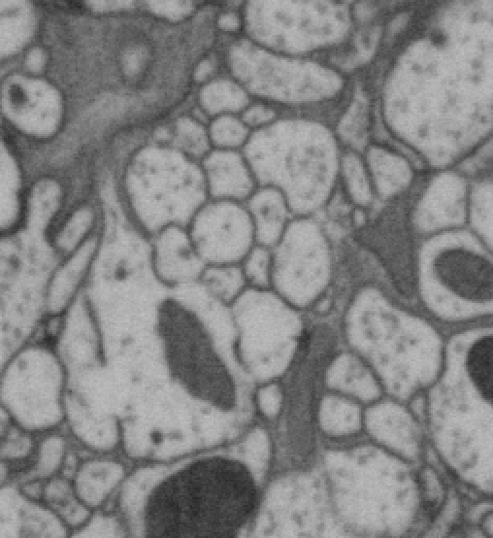
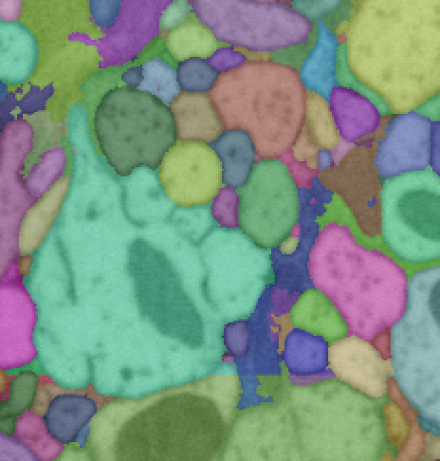
High-level: why segmentation is challenging (pt 2)
Imperfections or anomalies in data (even a small number of artifacts can render the resulting graph useless)
results in falsely merging parts of two different neurons
membrane holes in original image data
Notes:
Small datasets will not fully reveal the large-scale impact of some of these errors. Due to finite training, lack of classifier generalizability could increase sensitivity to data anomalies.

Slide 9
High-level: why segmentation is challenging (pt 3)
Connectomics is a relatively new field
Limited training data (small, incomplete reconstructions, etc)
Do we need more domain experience? – might take some time
Fly medulla reconstruction [PNAS ’15]
~30,000 cubic microns (state-of-art reconstruction but only small fraction of fly brain)
very small training datasets does not contain relevant biology
Typical evaluation dataset size (1/30th size)
Notes:
The good news is that connectomics is relatively new and there has been a lot of progress.

Slide 10
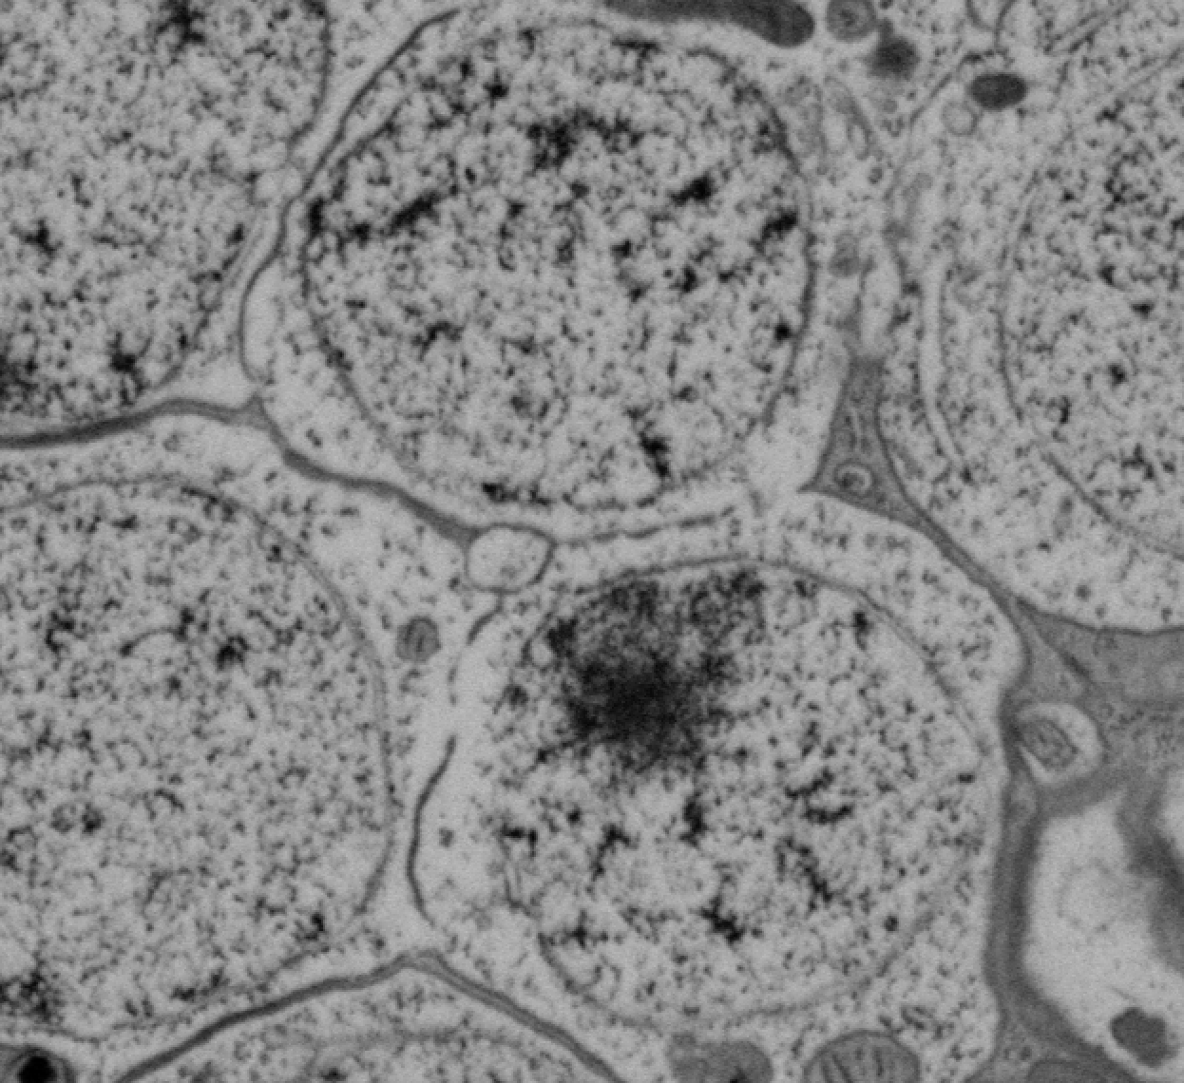
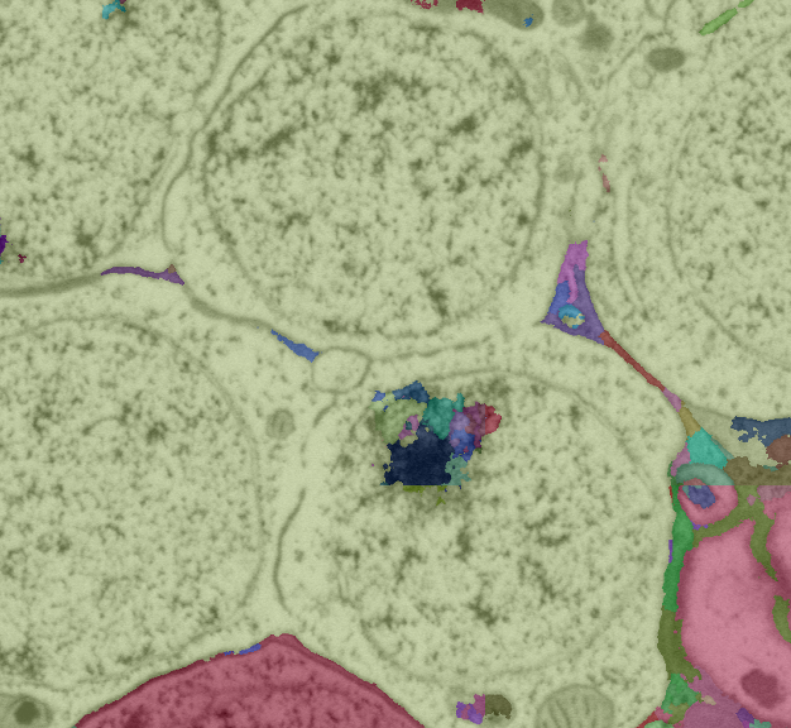
Where segmentation fails
Small errors can have large topological impact (segmentation typically done with low-dimensional features)
Poor classifier generalizability (untrained areas can perform poorly)
Notes:
Even if the current objective is slightly wrong, why is segmentation failing to extract neurons and connectomes?
Near perfection is needed in terms of pixel correctness because small errors can lead to very large topological errors.
This perfection is also hard to achieve on a large dataset because a classifier might not generalize to all the data.

Slide 11
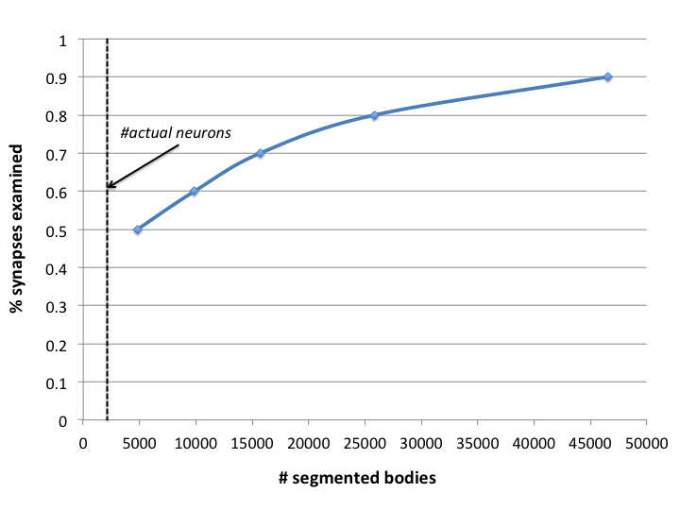
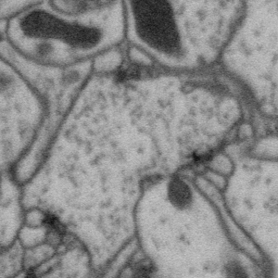
Where segmentation fails (pt 2)
Small neurites and thin processes challenge image resolution limits
Hard to manually proofread
Often under-weighted evaluation or conservatively fragmented
Large number of small segments to contain 100% of all synapses
small neurites: 10-40 nanometer
Notes:
Conservative segmentation to avoid false mergers affects both big neuron shapes and small processes. When weighting a segment size by number of synapse annotations instead of voxel count the fragmentation seen is more profound.
We therefore make catastrophically bad errors, and often to protect against these errors, we make a lot of small errors that directly hurts the connectome.
ZZ: Add histogram for volume and synapse volume (to show volume is optimized over synapse and to show that tail.

Slide 12
It is hard to solve a poorly defined question
Actual objective is a connectome graph, not (only) neuronal shapes (complication: “what is a connectome” has changed over the years)
We do not have a clear metric(s) that reflects this objective
Pixel perfect segmentation → perfect reconstruction ... does that tell us anything?
Problem: small dendrites involve few pixels, but directly impact connectome
EM
?
there are connections! (synapses)
example: Rand index gives topological similarity
Seg A
Seg B
$$≈$$
Seg A
Seg B
small pixel differences don’t affect topology
Notes:
Connectome graph will be 100% correct if we have perfect neuronal segmentation and synapses are annotated (either manually or some reasonably accurate algorithm). In earlier work, a connectome did not explicitly incorporate synaptic connections but contact points between neurons.
A perfect Rand or VI score would give a correct connectome (assuming synapses). But perfection is impossible and anything less than 100% could be hard to interpret … these metrics do not reflect biology

Slide 13
Solutions

Slide 14
Ingredients for a good segmentation
Define the problem better: what is a complete connectome?
Biological systems have errors, algorithms make errors → what can we tolerate?
100% is unnecessary examples ==> Takemura ’13 and ’15: <100% connectivity ==> Elife, Cardona ’16: might not need to trace neuron tips
…do not need to be perfect
Neuron C
Neuron B
Neuron B
Neuron A
Neuron A
Notes:
Many neuronal pathways have multiple connections between the same neurons; there is redundancy in the circuit.
Cardona et al, also show that in some cases reconstructing the peripheral tips of a neuron is not always necessary.

Slide 15
Ingredients for a good segmentation (pt 2)
Incorporate manual proofreading into segmentation objectives
Proofreading will be a part of reconstruction for awhile
Segmentation tuned to minimize false mergers
Proofreading time should be accounted for in segmentation evaluation (“nuisance metric”)
Focused proofreading to target most uncertain parts of the segmentation → both improve segmentation and reduce proofreading effort
Notes:
Manual proofreading is very costly but sadly necessary with current segmentation quality. Manual proofreading cost will likely dominate for some time. For every 1 cpu hour to generate segmentation, we might need 10 hours of manual labor. Segmentation needs to improve by 1000x to make the cost of manual correction similar to CPU cost (assuming conservative 100 cpu hours ~ 1 human hour). This is ignoring speedups in computation and use of GPUs which exacerbates the differences even more.

Slide 16
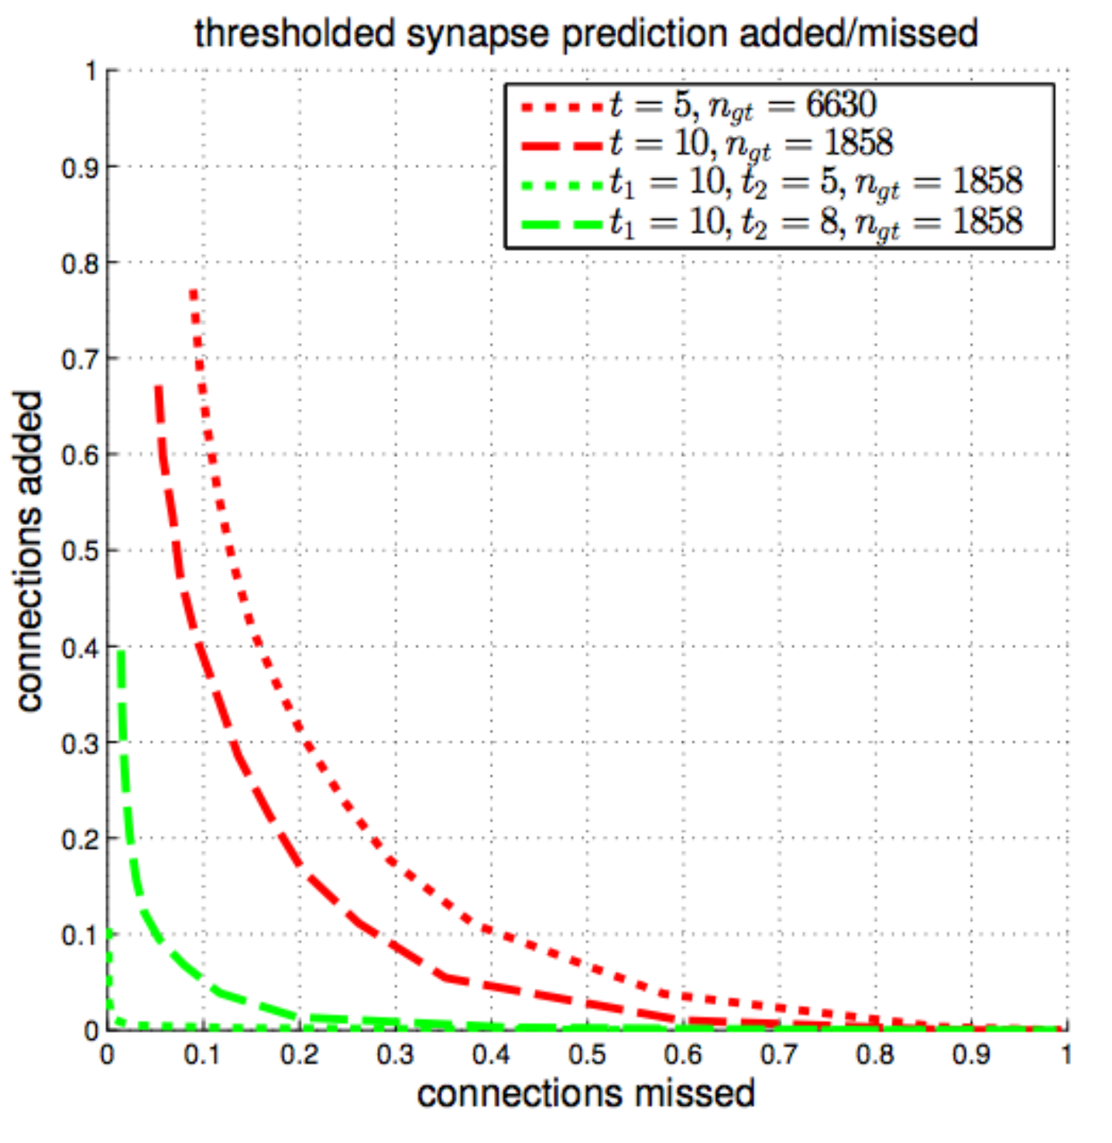
Ingredients for good segmentation (pt 3)
Explore different evaluation objectives for different parts of dataset and pipeline
Traditional, voxel-based objective (like Rand, VI) to evaluate/segment large bodies
Use large dataset for validation
Challenges: 1) how to avoid bad false merging? 2) big data challenges
Synapse-based objectives to directly evaluate connectivity
Need annotated synapses (manual or automatic)
Better reflect biological goals (better tolerate errors)
Examples: synapse VI, number of “orphan” fragments
Potential “smaller-data” solutions
Challenges: 1) limited training data (sparser) 2) many regions even difficult to manually trace
accuracy “improves” when considering restricting to pathways with higher synapse counts
Example: Accuracy of automatic synapse prediction applied to densely proofread volume [Huang ‘15]
Notes:
synapse connectivity is a biologically more relevant metric but synapses and small processes are sparse in image space and tend to be in noisy, hard-to-train regions. We are tolerant of some errors since small false merges, lead to only small connectomic changes. There are some simple priors that can be used as a small segment should either leave the dataset or be connected to a ‘bigger’ segment.
voxel-based objectives better reflect the image data and are appropriate for basic neuronal shape where there are dense labels making up most of the training data. Classifiers in this space are tuned to over-merge and are less tolerant of errors.

Slide 17
Our proposed workflow (proofreading + segmentation)
Initial Segmentation (”traditional approach”)
TODO: Top-down Segmentation and Shape Constraints
Manually Proofread Large Bodies
TODO: Attach small orphan processes to large bodies (avoid large mergers)
”large bodies”
Automatic Synapse Prediction
Good Enough Connectome (up to 10x reduction in work)
“completeness”
number of segments to examine (i.e., work)
Notes:
We limit manual proofreading by 1) explicitly not requiring a 100% complete connectome, 2) improving the quality of initial segmentation and top-down segmentation to get body shapes and 3) algorithms to automatically attach small processes to large bodies.
We have seen some examples where the tail is very long and the number of big bodies (with at least some synapse annotation) is a small fraction of the total number of segments that would give a 100% connectome. We can potentially avoid doing a lot of this work while still preserving the result.
Automatic attaching small bodies can be done in a way that avoids mergers between the large bodies. Therefore we can tolerate some errors in these algorithms. We can also safely limit training/validation to smaller datasets since high-level shapes are less relevant here.

Slide 18
Short-term needs
Development of more top-down segmentation strategies to extract neurons (need richer set of high-level features such as those representing neuron shape)
Segmentation strategies tuned to handle sparse, noisy, hard-to-segment regions (e.g., thin dendritic processes) perhaps exploiting more biological priors
Better understand acceptable connectome errors → develop segmentation algorithms to operate within this regime
Improve uncertainty estimation and strategies to better focus proofreading and synergistically aid image segmentation
Notes:
Top-down strategies might be necessary to avoid catastrophic errors.
Acceptable connectome errors will vary depending on the biological goals. Given these goals, the segmentation can exploit any flexibility (i.e., where accuracy does not need to be as great) but ensure that some minimal standard is achieved.

